Slide 1


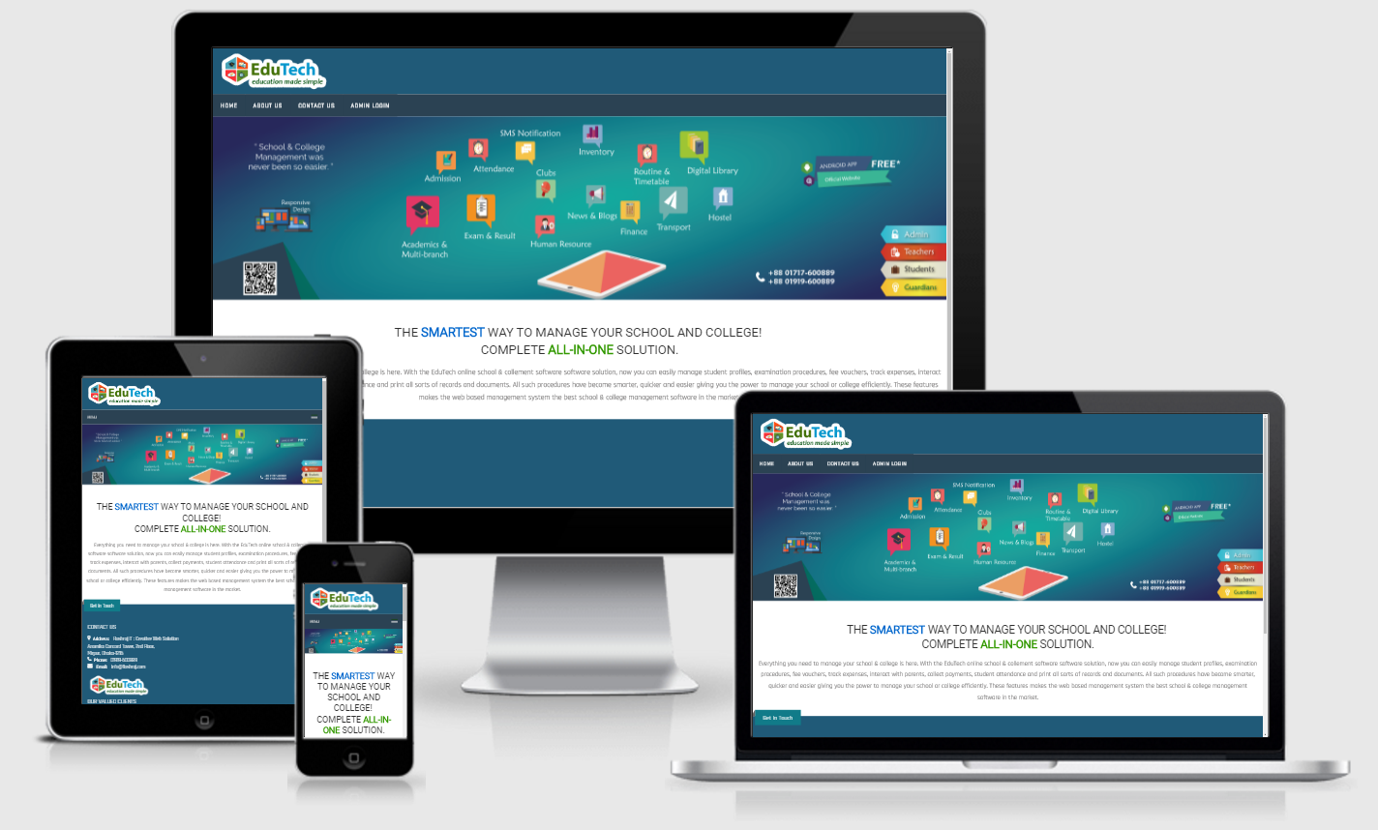
Presented by
------------------------------------- Md. Shirajul Islam
Lead Software Developer, Flashraj IT
Sabrina Rafi
Sr. Manager, Branding & Promotion

Slide 2




About Flashraj IT
Established in 2010
Focused on Software Development
Completed more than 500 web based software solution.
Software development for local and international clients.
Major ERP Software:
Website: http://flashraj.com

Slide 3








Some Major Local & International Clients

Slide 4








MAJOR CLIENT (EduTech)

Slide 5
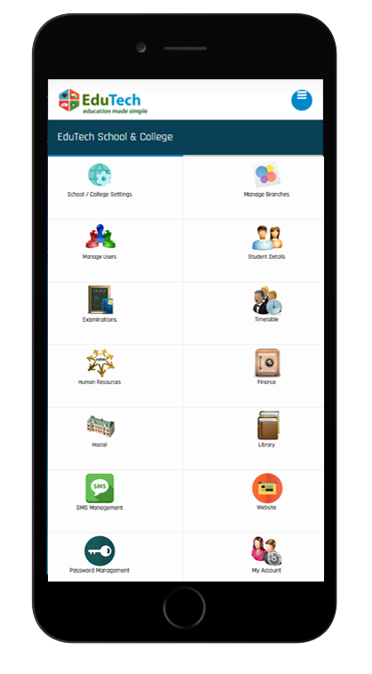
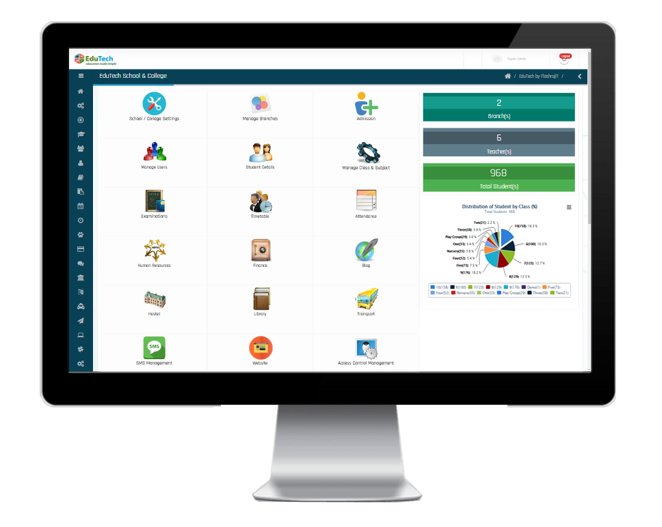

http://edutech.flashraj.com

Slide 6



Basic Modules
Advanced Modules
Pre-admission & Admission (Online)
Student’s Database with Dynamic Search
Teacher’s Database
Attendance with SMS notification
Exam & Result Processing with SMS
Human Resource
Routine & Timetable
SMS Broadcasting
Financial Report
Library Management
Hostel Management
Club Management
Transport Management
Fee Card Management
Online Homework
Survey Management
Extra Curricular Activities
Inventory Management

Slide 7


Benefits of using EduTech
Single software to manage all School related information from anywhere
Complete Automation of manual operations
Analytical & Statistical reports for better decision making for management
Multiple Branch Management
Students & Parents have access to all academic information
Cost-effective one point solution for total institute management
Save a lots of investment in different software and management issues.
Centrally stored information with zero redundancy
Best possible resource optimization
Effective communication between teachers, parents and students
Creation of school/ college’s digital & tech savvy image.

Slide 8

Benefits for Students
Enhanced interaction with teachers, parents and friends.
Access to attendance, timetable, marks, grades and examination schedule
Freedom to browse through library books catalogue and identify the book(s) to be issued
Prior information about school events and holidays.
Student Login panel, SMS notification
Liberty to publish articles and views, and participate in discussion forums

Slide 9


Slide 10
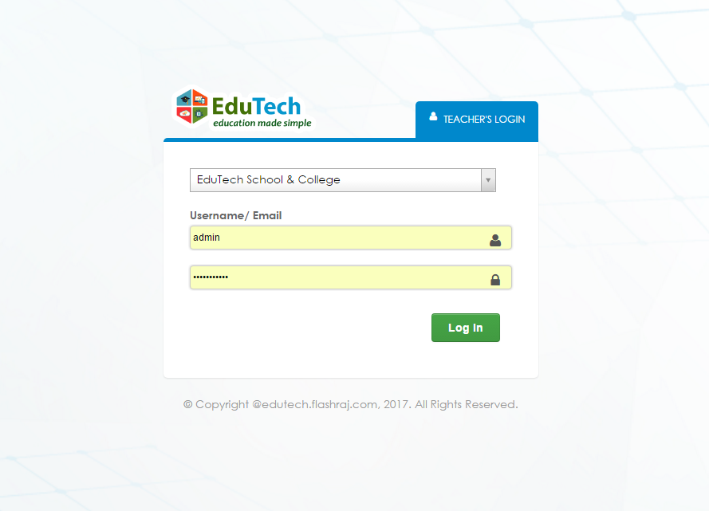
Login Panel

Slide 11
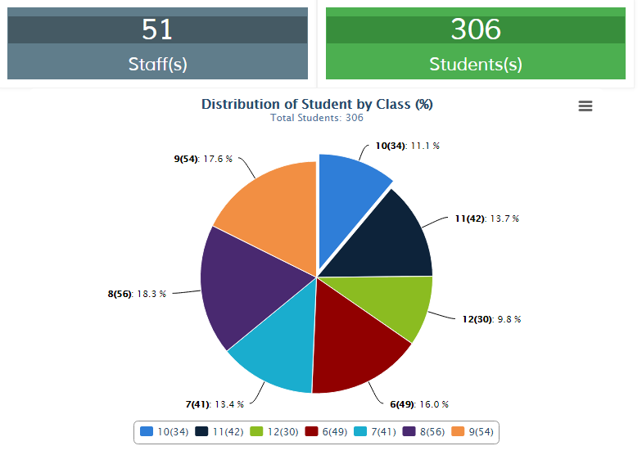
Graphical Reports

Slide 12
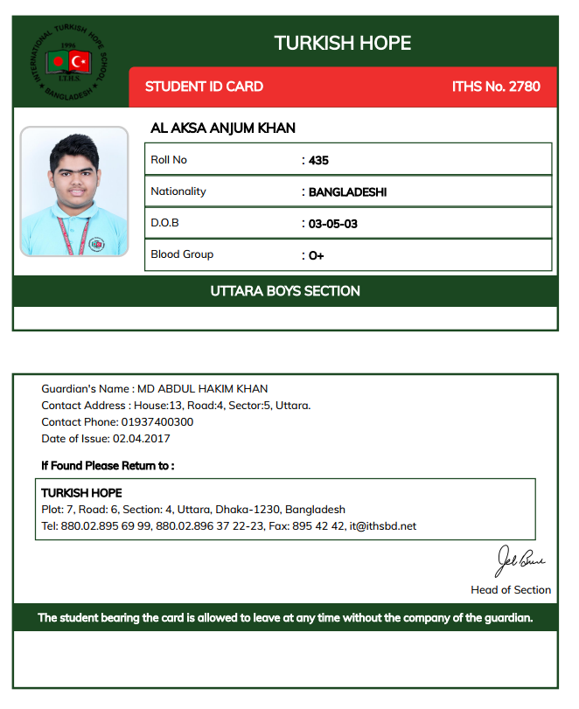
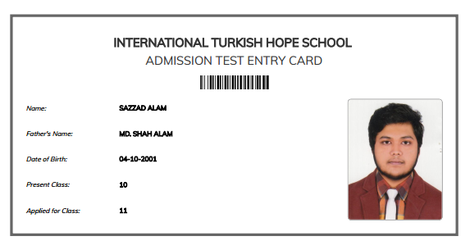

Slide 13
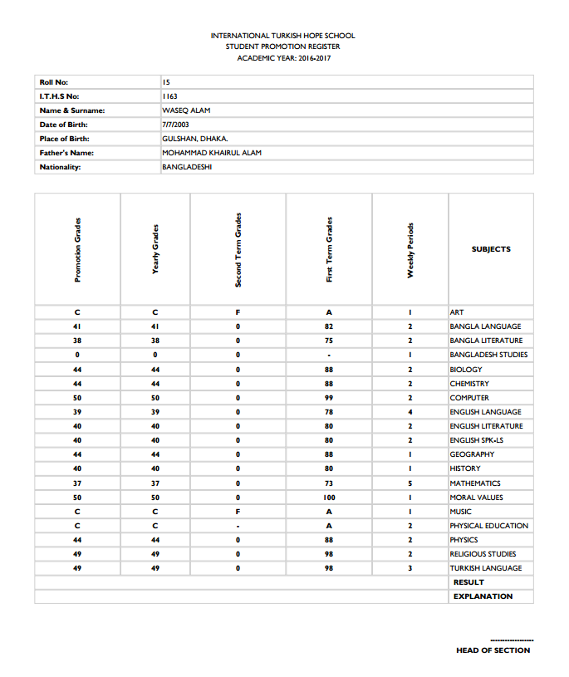
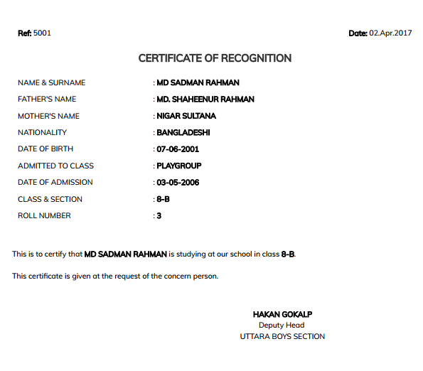

Slide 14
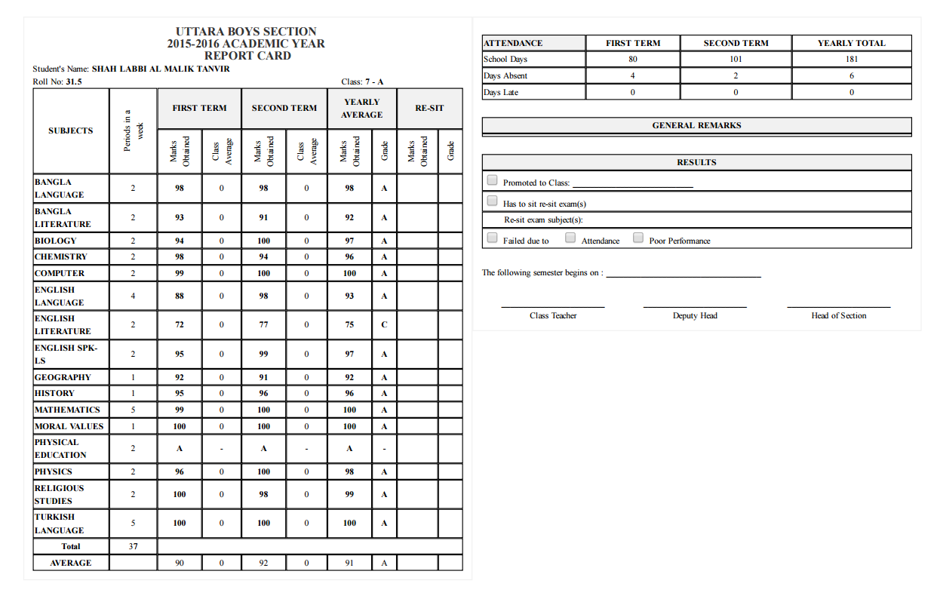

Slide 15
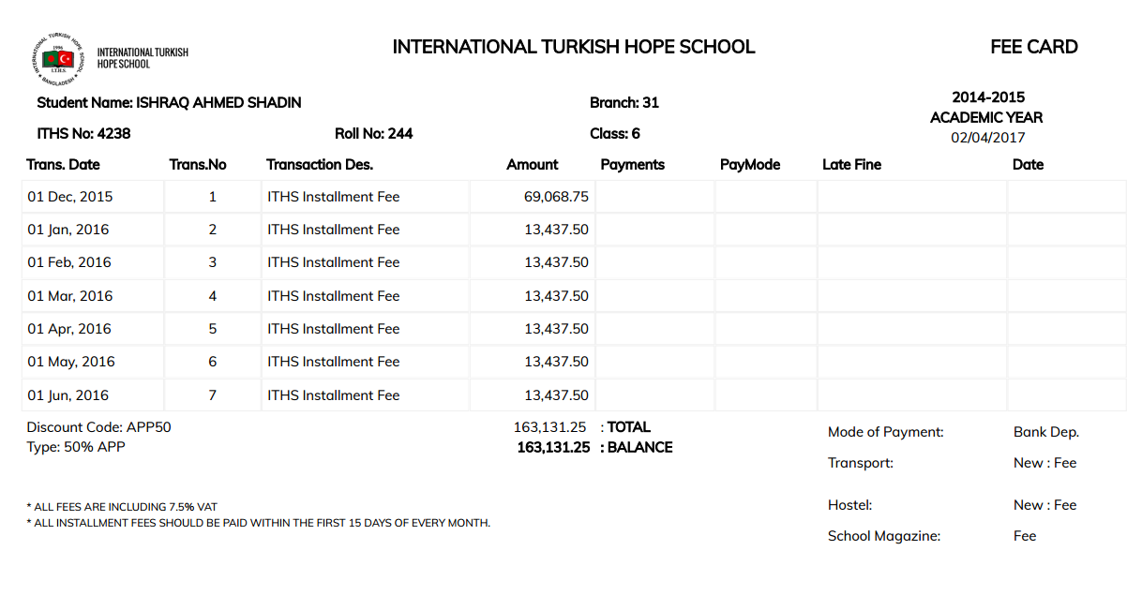

Slide 16
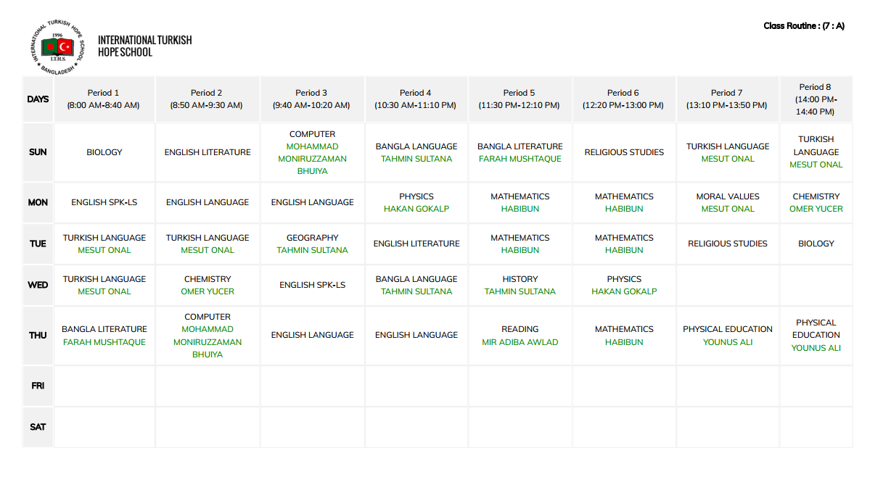

Slide 17


Slide 18

Live Demonstration

Slide 19

Thanks for staying with us.

